Slide 1

Dashboarding in Shiny
By: Tonya Filz

Slide 2

Agenda
Possibilities
Basic Components
UI
Header
Sidebar
Body
Server
Model
Example
Resources
Wrapup

Slide 3
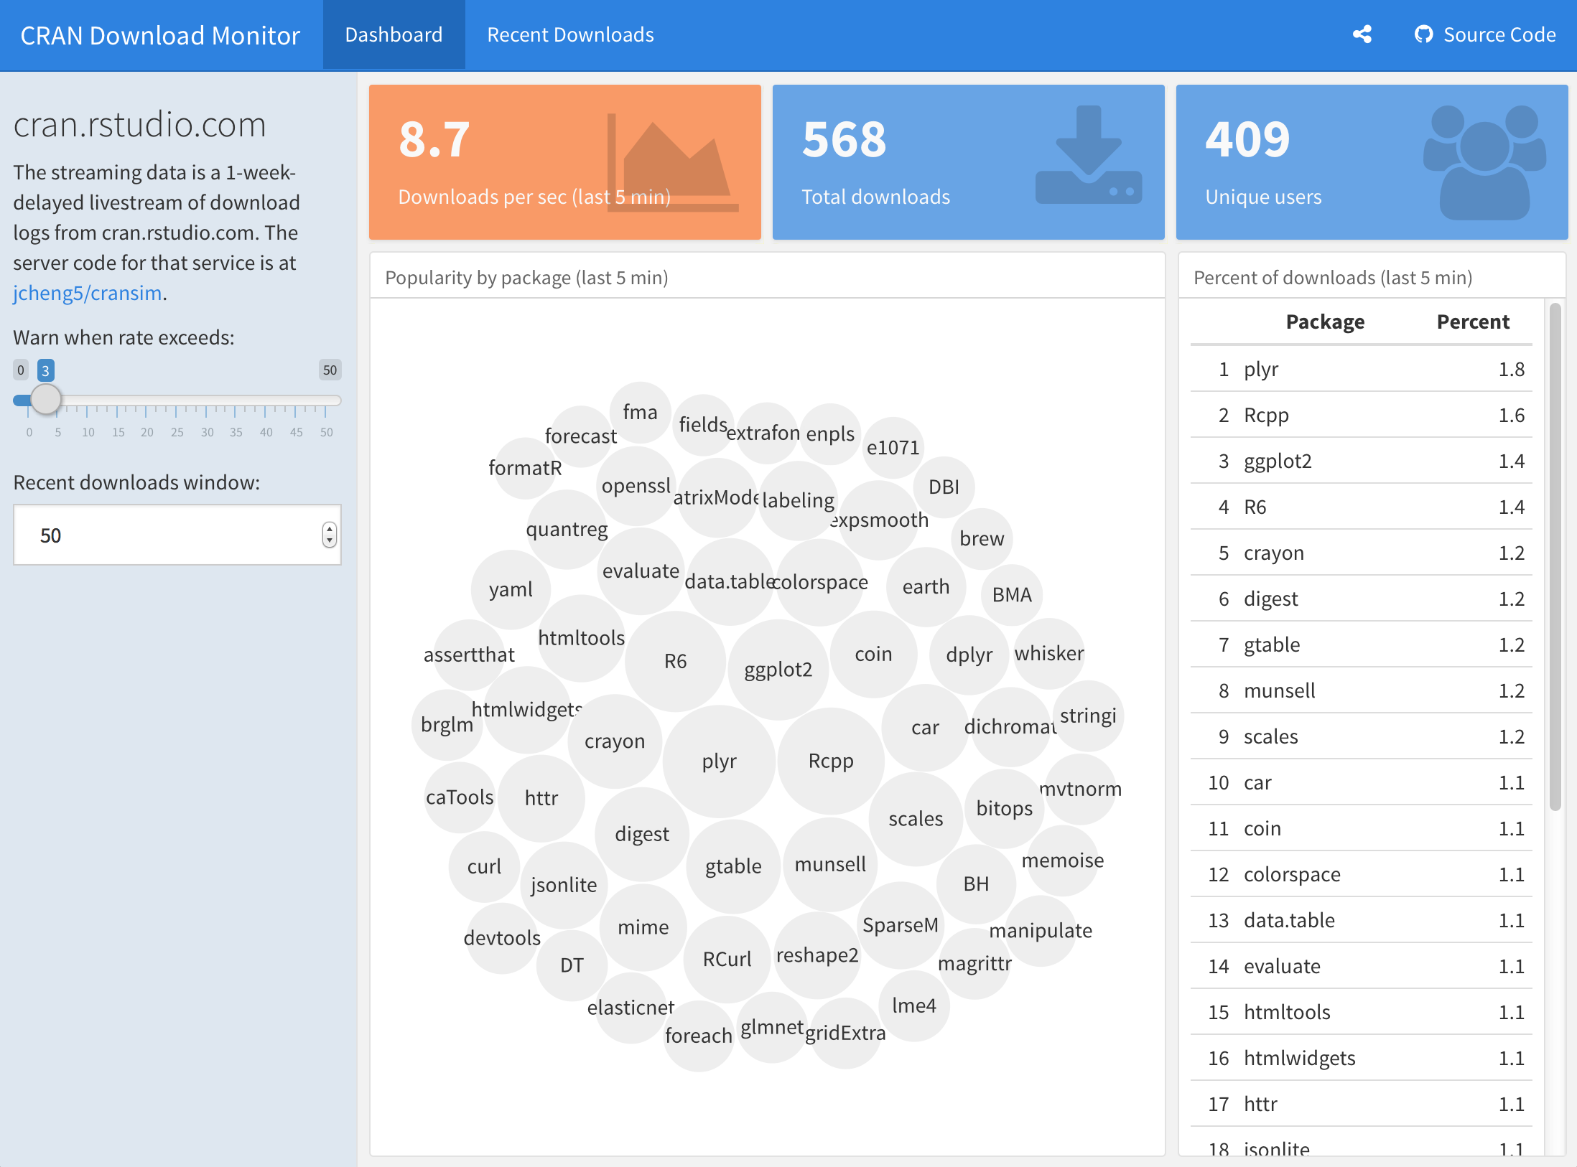
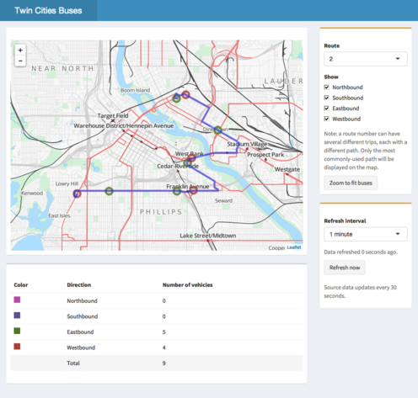
Possibilities
A dynamic word cloud dashboard
A dashboard with the leaflet package

Slide 4
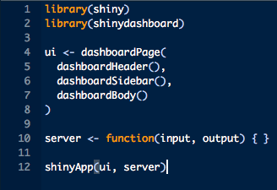
The Basics
Same UI/Server format as Shiny applications
UI calls specific dashboard components
Server will contain your same R model, plus a few shiny reactive components
Start with this (or another) shiny dashboard template
Notes:
This code will run, but will open up a blank dashboard.
Many teams that run production level shiny dashboards will

Slide 5
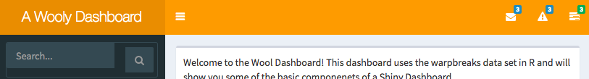
Dashboard: Header
Message menu
Notifications Menu
Task Menu
Disable option
dashboardHeader(disable = TRUE)

Slide 6
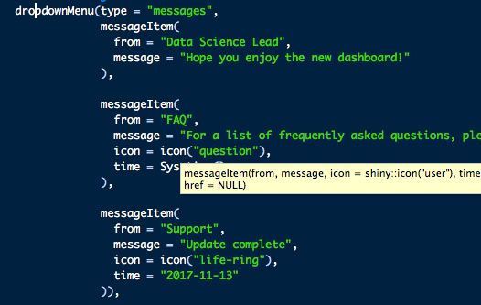
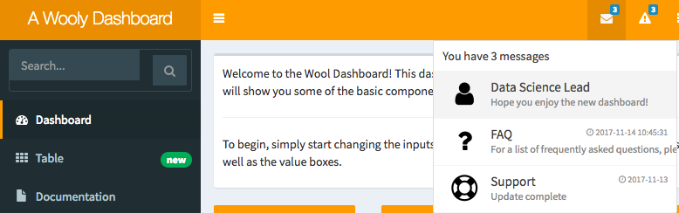
Dashboard: Header

Slide 7
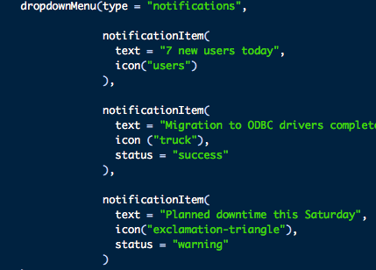
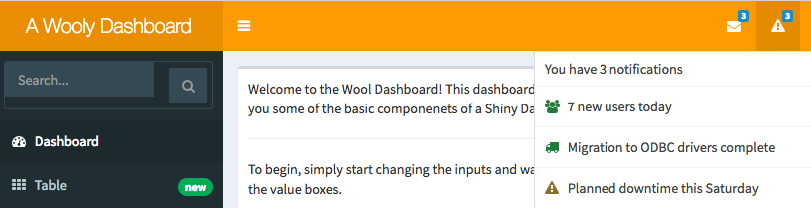
Dashboard Header

Slide 8
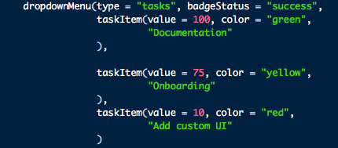
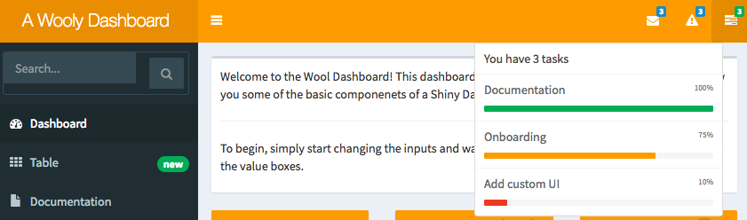
Dashboard Header

Slide 9
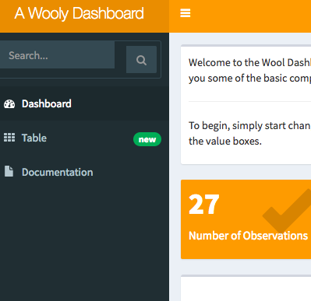
Dashboard: Sidebar
Can contain:
Inputs
Dashboards
Fully customizable appearance
Possibilities are endless!
Notes:
Bookmarking, printable reports, uploads, search,

Slide 10
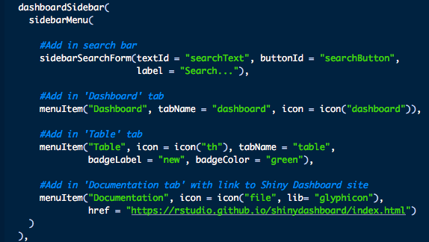
Dashboard: sidebar

Slide 11
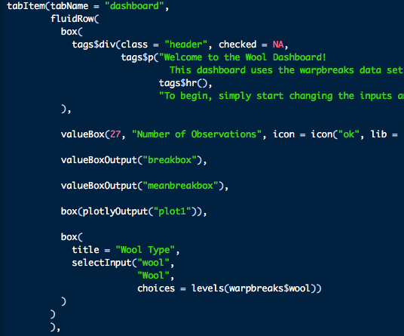
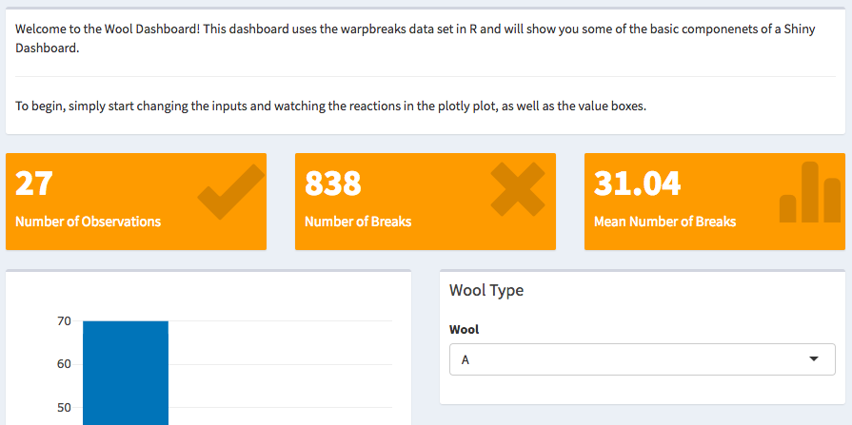
Dashboard: Body

Slide 12
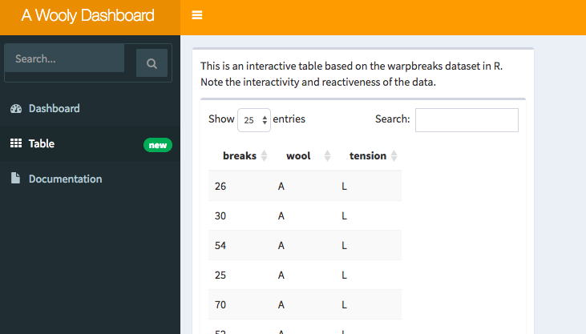
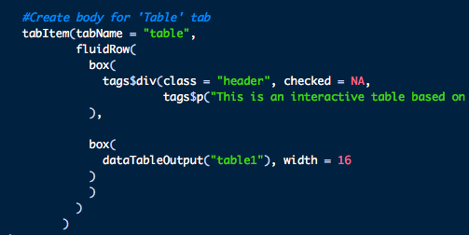
Dashboard: Body

Slide 13
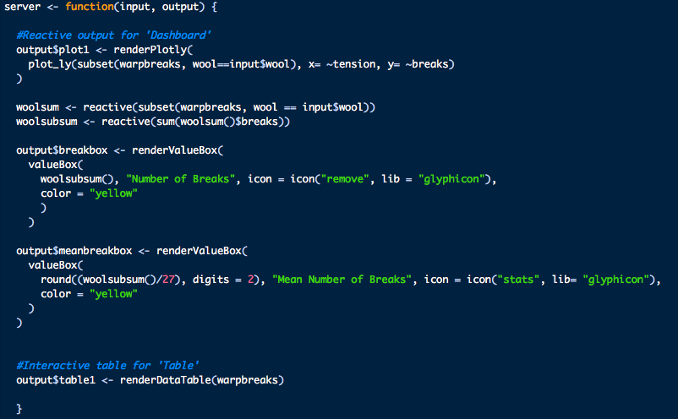
Model

Slide 14
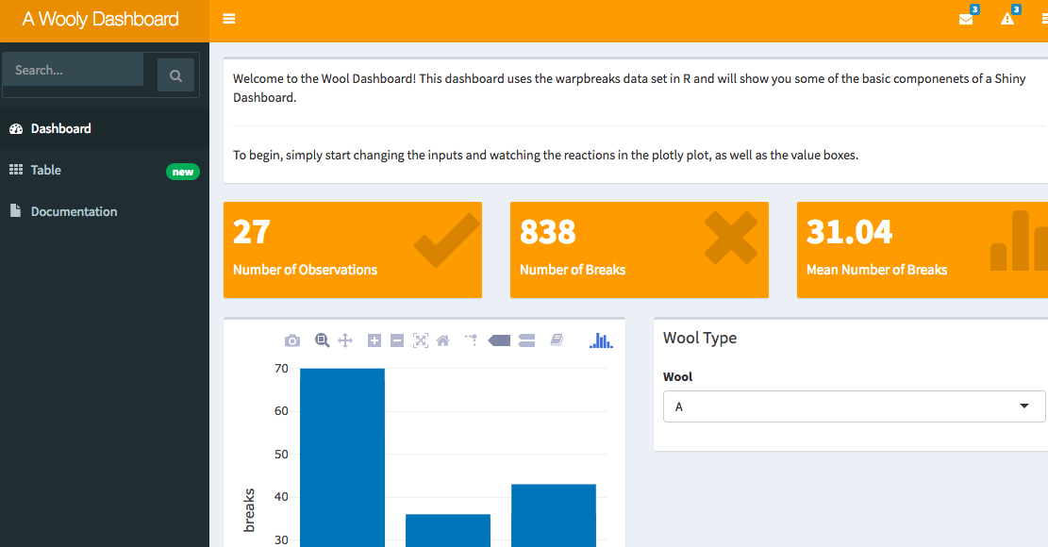
An Example

Slide 15
Resources to note
Shiny
Gallery: https://shiny.rstudio.com/gallery/
Cheatsheet: http://shiny.rstudio.com/images/shiny-cheatsheet.pdf
Learning Shiny
Shiny references: https://shiny.rstudio.com/articles/
Shiny webinar: https://www.rstudio.com/resources/webinars/
Shinydashboard: https://rstudio.github.io/shinydashboard/
Basic tutorial: https://rstudio.github.io/shinydashboard/get_started.html
Advanced tutorial: https://rstudio.github.io/shinydashboard/structure.html
CSS tags: https://shiny.rstudio.com/articles/tag-glossary.html
Glyphicons: https://getbootstrap.com/docs/3.3/components/
Advanced Shiny
Bookmarkeable State: https://shiny.rstudio.com/articles/bookmarking-state.html
Custom Appearance (HTML required): https://shiny.rstudio.com/articles/html-tags.html
Custom Appearance (CSS required): https://shiny.rstudio.com/articles/css.html
Shiny Gadgets: https://shiny.rstudio.com/articles/gadgets.html.
Linked Brushing: https://rstudio.github.io/crosstalk/shiny.html
Modularizing shiny code: https://shiny.rstudio.com/articles/modules.html
Profiling and Performance: https://shiny.rstudio.com/articles/profiling.html
Shiny Datatables: https://shiny.rstudio.com/articles/datatables.html

Slide 16
(More) Resources to Note
Deployment
Connect: https://www.rstudio.com/products/connect/
.Shiny apps.io: http://www.shinyapps.io/
Shiny Server (Open Source or Professional): https://www.rstudio.com/products/shiny/shiny-server/
Support
RStudio Community: https://community.rstudio.com/
Stackoverflow: https://stackoverflow.com/

Slide 17
Any Questions?

